Slide 1
B.I Project Palais du Bonbon
Gaëtan LOPEZ CUTILLAS, Thomas DROUIN, Zac MENENDEZ, François KODJOVI

Slide 2
Summary
Project Team
Context and Goals
Project Management
Application
Storage and communication
Reporting and dashboards
B.I synthesis
Conclusion

Slide 3
Project Team
Gaëtan : Project Manager, Scrum Master, Assistant Developer
Thomas : Lead Developer, Development Architect, UML Conceptor
Zac : DBA, System Technician, Merise Architect
François : Responsible for BI, Dashboard Conceptor
Project Team
Context and Goals
Project Management
Application
Storage and communication
Reporting and dashboards
B.I synthesis
Conclusion

Slide 4
Palais du bonbon and Goals
Supply chain
Eastern Competitors
Cyberattack : MongoDB
Last year Data
Data Analysis
Optimization
Supply chain simulations
Oracle, ETL
Project Team
Context and Goals
Project Management
Application
Storage and communication
Reporting and dashboards
B.I synthesis
Conclusion

Slide 5
Project Management Work Breakdown (pages 7, 8 and 9)
Zac
Databases
ETL (Extract Transform Load)
KPI (Key Perfomance Indicator)
Thomas
UML
Generator
Simulator
Entity Framework
François
POC ETL
KPI
Dashboard
Business Intelligence
Gaëtan
Management
POC Entity
Writting
Project Team
Context and Goals
Project Management
Application
Storage and communication
Reporting and dashboards
B.I synthesis
Conclusion

Slide 6
Project Management Scrum
Daily-meeting
Project Monitoring
Knowledge of others work
Retrospective meetings
Project Team
Context and Goals
Project Management
Application
Storage and communication
Reporting and dashboards
B.I synthesis
Conclusion

Slide 7
Project Management Git
Versioning
Sharing
Cloud Computing
Project Team
Context and Goals
Project Management
Application
Storage and communication
Reporting and dashboards
B.I synthesis
Conclusion

Slide 8
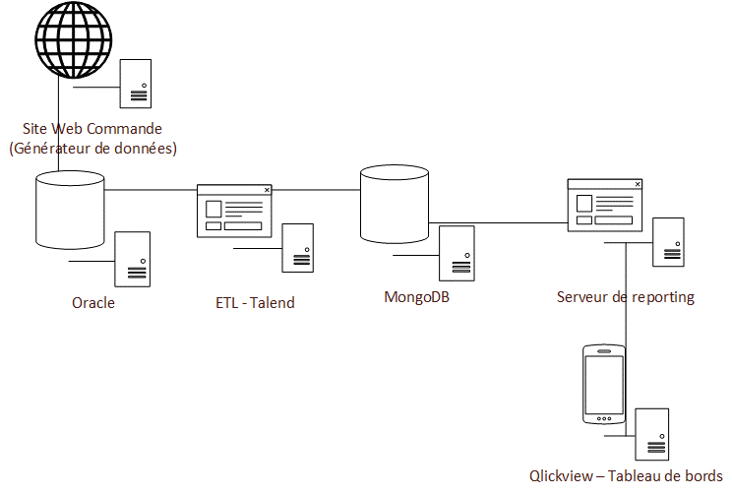
Project Architecture
Project Team
Context and Goals
Project Management
Application
Storage and communication
Reporting and dashboards
B.I synthesis
Conclusion

Slide 9

Data Generator
Generating Consistent Data
Pushing Data
Project Team
Context and Goals
Project Management
Application
Storage and communication
Reporting and dashboards
B.I synthesis
Conclusion

Slide 10

Data Simulator
Simulation of manufacturing, packaging and preparation time
Reproduces the operation of the company supply chain
50%
50%
Project Team
Context and Goals
Project Management
Application
Storage and communication
Reporting and dashboards
B.I synthesis
Conclusion

Slide 11
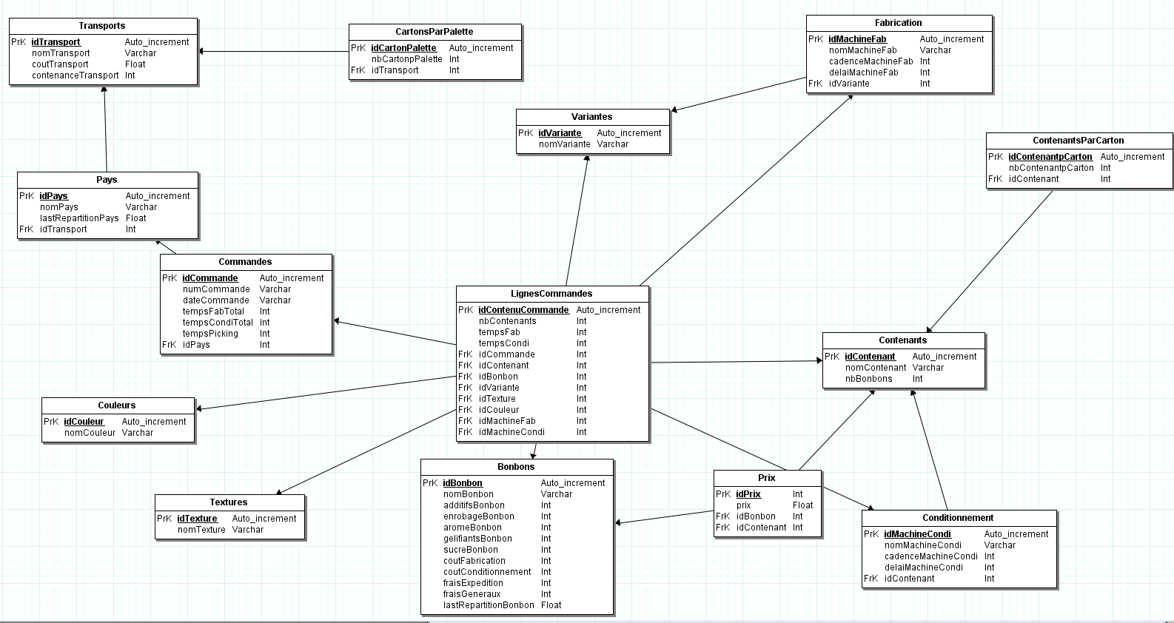
Data Storage Merise
Project Team
Context and Goals
Project Management
Application
Storage and communication
Reporting and dashboards
B.I synthesis
Conclusion

Slide 13


Data Storage DataBase
Oracle
Relational
Trigger
MongoDB
NoSQL
Document
Project Team
Context and Goals
Project Management
Application
Storage and communication
Reporting and dashboards
B.I synthesis
Conclusion

Slide 14
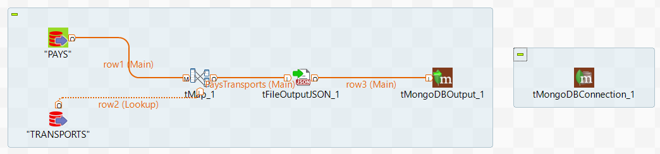
Data Storage ETL - Talend
Database Connection
JSON
Join
Script execution
Project Team
Context and Goals
Project Management
Application
Storage and communication
Reporting and dashboards
B.I synthesis
Conclusion

Slide 15
Reporting : few KPI
Manufacturing service
Numbers of candies by days
Packaging service
Numbers of packing by days
Orders preparation service
Orders by days
Purchase service
Candies by distribution
Candies by global price
Maintenance service
Number of tool change by days
Project Team
Context and Goals
Project Management
Application
Storage and communication
Reporting and dashboards
B.I synthesis
Conclusion

Slide 16
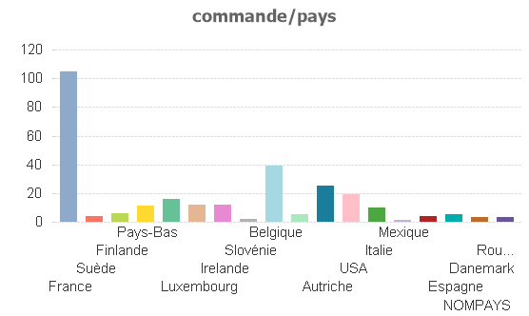
Reporting : Dashboard Qlikview
Project Team
Context and Goals
Project Management
Application
Storage and communication
Reporting and dashboards
B.I synthesis
Conclusion

Slide 17
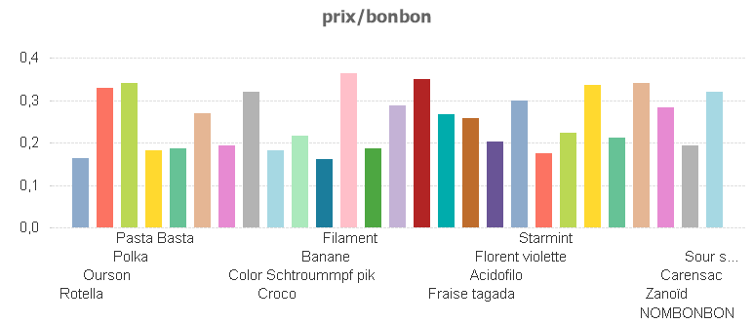
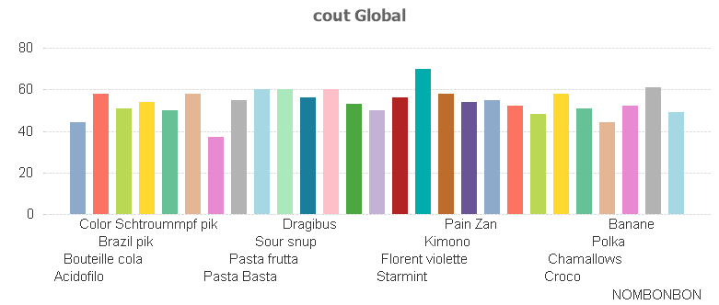
Reporting : Dashboard Qlikview
Project Team
Context and Goals
Project Management
Application
Storage and communication
Reporting and dashboards
B.I synthesis
Conclusion

Slide 18
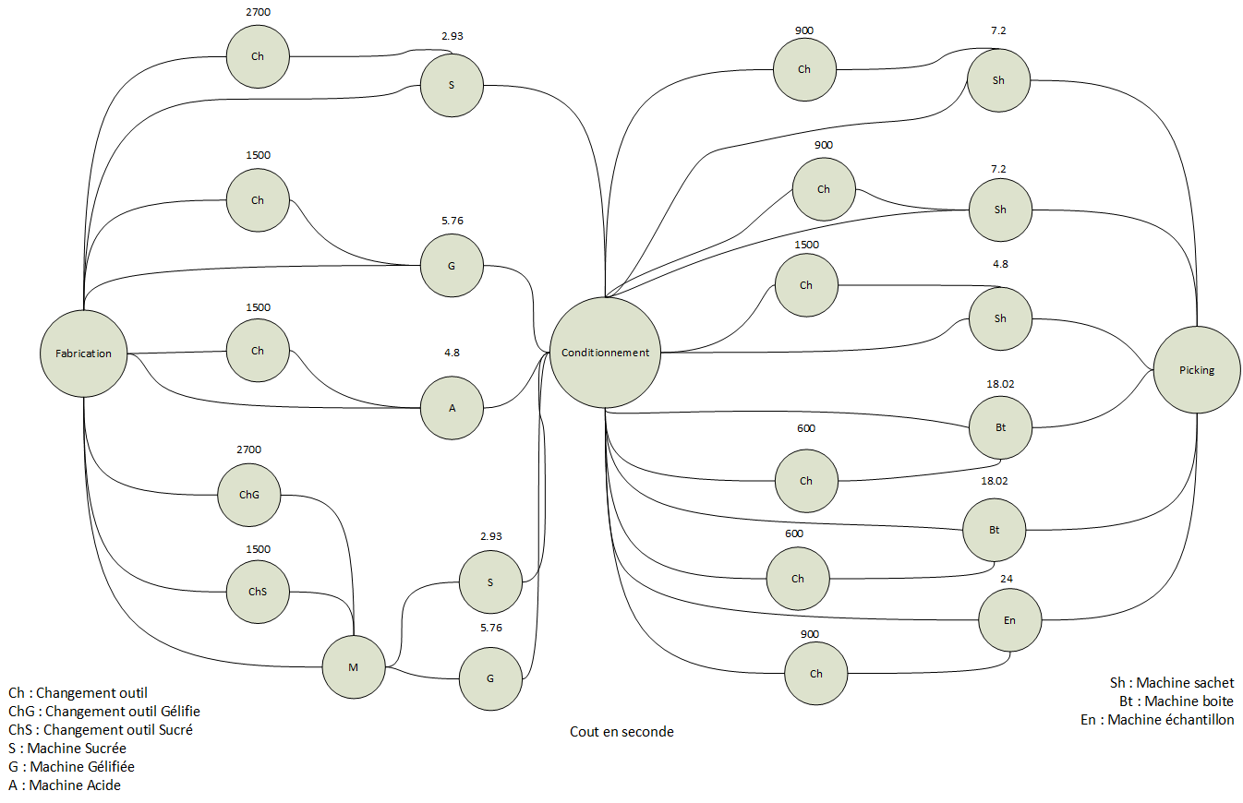
Theorie Graphe
Project Team
Context and Goals
Project Management
Application
Storage and communication
Reporting and dashboards
B.I synthesis
Conclusion

Slide 19
B.I synthesis
Issues | Solutions
Changing machine tools | Manufacturing by type
A machine manufacturing sugar and gelled candies | The most expensive variety is divided between both machines
Random picking area | Docks are sort by orders
Inconsistency in selling prices | Consistent manufacturing prices
Project Team
Context and Goals
Project Management
Application
Storage and communication
Reporting and dashboards
B.I synthesis
Conclusion

Slide 20
Conclusion
Team involved
Management project
Thanks
Project Team
Context and Goals
Project Management
Application
Storage and communication
Reporting and dashboards
B.I synthesis
Conclusion

